Slide 1
SAML 2.0 and XACML

Slide 2
SAML 2.0
Federation refers to the establishment of some or all of business agreements, cryptographic trust, and user identifiers or attributes across security and policy domains to enable more seamless cross-domain business interactions. As Web services promise to enable integration between business partners through loose coupling at the application and messaging layer, federation does so at the identity management layer — insulating each domain from the details of the others' authentication and authorization infrastructure. Key to this loose coupling at the identity management layer are standardized mechanisms and formats for the communication of identity information between the domains — the standard provides the insulating buffer. SAML defines just such a standard.
Security Assertion Markup Language (SAML) is an XML standard for exchanging authentication and authorization data between security domains.
Need for SAML:
Limitations of Browser cookies: Most existing Single-Sign On products use browser cookies to maintain state so that re-authentication is not required. Browser cookies are not transferred between DNS domains. So, if you obtain a cookie from www.abc.com, then that cookie will not be sent in any HTTP messages to www.xyz.com. This could even apply within an organization that has separate DNS domains. Therefore, to solve the Cross-Domain SSO (CDSSO) problem requires the application of different technology. All SSO products solve the CDSSO problem by different techniques.
SSO Interoperability: How products implement SSO and CDSSO are completely proprietary. If you are an organization and you want to perform SSO across different DNS domains within the same organization or you want to perform CDSSO to trading partners, then you will have to use the same SSO product in all the domains.

Slide 3
Features in SAML:
Support for Single Sign On among trusted partners that reside in different DNS domains.
Support for Single Log out among trusted partners that reside in different DNS domains.
Support for federation of identities or account linking to address the interoperability issue and enable organizations to share trusted identities across the boundaries that separate them.
Enables sharing of attributes among trusted partners.

Slide 4
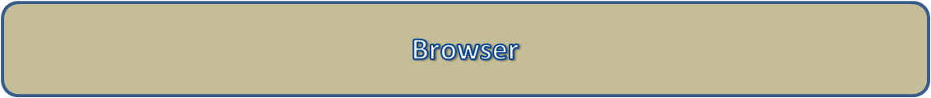
SP 1
SP 2
SP 3
ID 2
ID 3
ID 1
CA 1
CA 2

Slide 5
Need for XACML :

